Slide 1
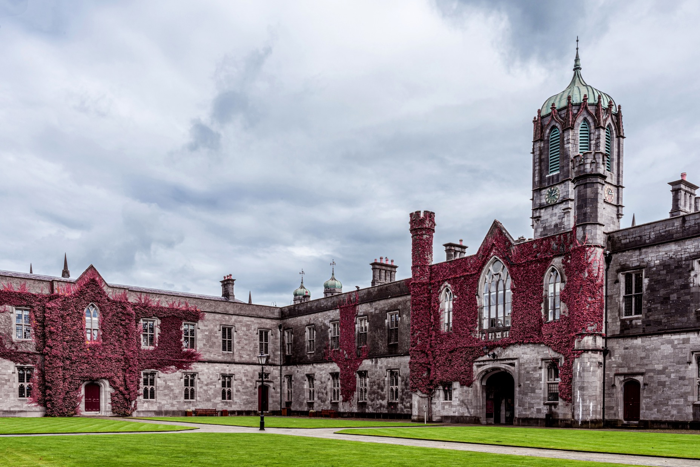
CT336/CT404 Graphics & Image Processing Sem 1 (Autumn) 2024-25, Dr. Nazre Batool 4th year B.Sc. (CS&I.T.). 2nd year M.Sc. (Software Development & Design) 1st year M.Sc. (Biomedical Engineering) Visiting students

Slide 2
Lecture 4: Image Processing
Introduction
Point Transformations: A pixel’s value is changed without changing its location.
Geometric Transformations: The location of a pixel is changed from the input to the output image.
Spatial Filtering (part 1 of 2)

Slide 3
Graphics vs. Image Processing vs. Computer Vision
1. Graphics:
processing and display of images of objects that exist conceptually rather than physically
emphasis on the generation of an image from a model of the objects, illumination, etc.
emphasis (often) on rendering efficiency for real-time display and/or realism
2. Image Processing:
processing and analysis of images of the real world
emphasis on the modification of the image
3. Computer Vision/Image Understanding:
Computer vision uses image processing and techniques from AI and pattern recognition to recognize and categorize image data and extraction of domain-specific information from images
Link to a University’s explanation

Slide 4
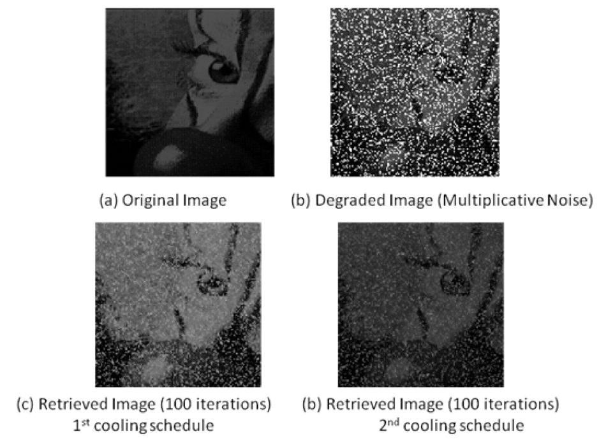
Image Processing Techniques
1. Image Enhancement:
provide more effective display of data for visual interpretation
increase the visual distinction between features in a scene.
2. Image Restoration:
correction of geometric distortions
Image de-noising
Image de-blurring
3. Feature Extraction
Extraction of useful features e.g. corners, blobs, edges, lines
Subtraction of background to extract foreground objects
Extraction of image segments, regions of interest
Image denoising using classical statistical approach

Slide 5
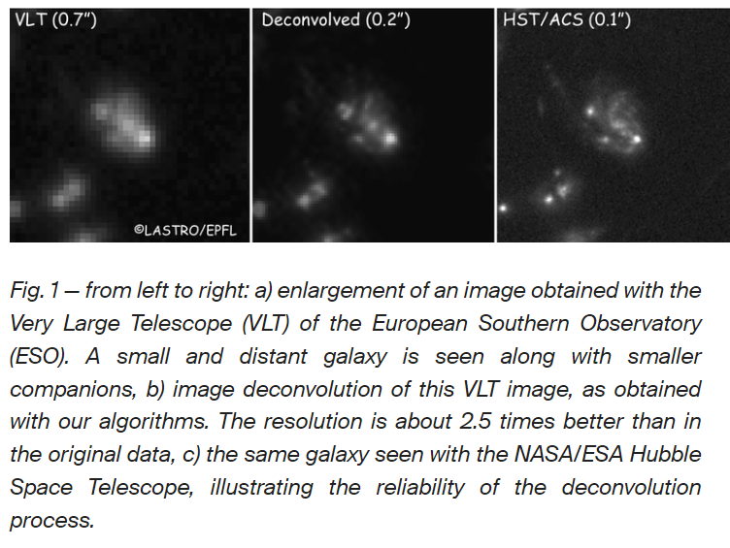
Image Processing Applications
Industrial inspection
Document image analysis
Traffic monitoring
Security and surveillance
Remote sensing
Scientific imaging
Medical imaging
Robotics and autonomous systems
Face analysis and biometrics
Entertainment
Astronomical image deblurring
reproduced from EPFL, Switzerland website https://www.epfl.ch/labs/lastro/scientific-activities/image-deconvolution/

Slide 6
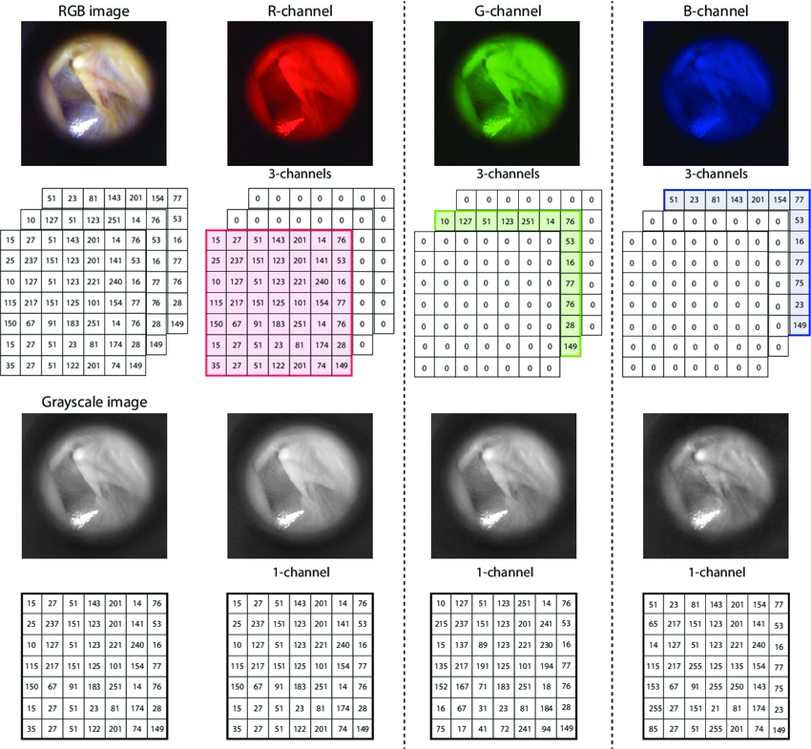
Digital Images - Bitmaps
Bitmaps: grid-based arrays of colour or brightness (greyscale) information
Pixels (picture elements): the cells of a bitmap
Depth: bits-per-pixel (bpp)
Image reproduced from [1]
[1] Color Dependence Analysis in a CNN-Based Computer-Aided Diagnosis System for Middle and External Ear Diseases - Scientific Figure on ResearchGate. Available from: https://www.researchgate.net/figure/Matrix-representation-of-a-digital-image-upper-row-from-left-to-right-image-in-the_fig2_359806413 [accessed 11 Sept 2024]

Slide 7
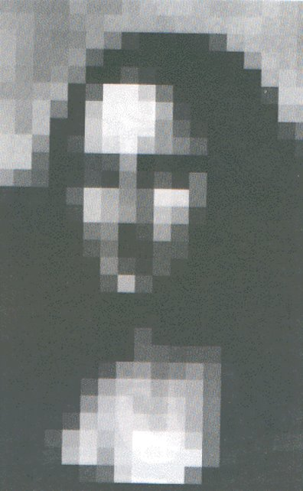
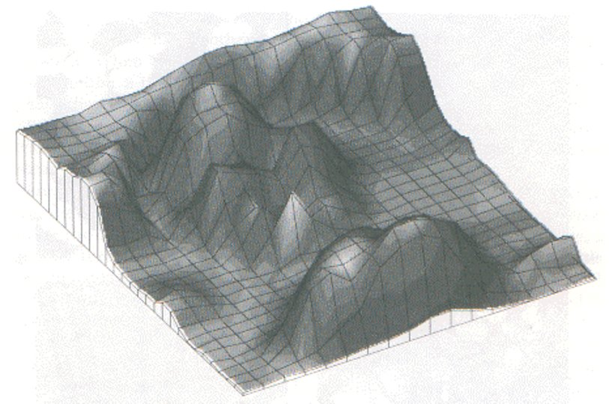

Slide 8

Introduction to OpenCV
For high-performance image processing, and to use pre-built library functions, one good choice is Open CV ​
Open Source Computer Vision Library (OpenCV) is an open source computer vision and machine learning software library, which is available for Python, C++, Java, Javascript.​
You can also write image processing code directly using Canvas and Javascript​
Or Matlab Image Processing & Computer Vision Toolboxes
Link to OpenCV-Python Tutorials
Link to OpenCV-Python Image Processing Module
https://opencv.org/

Slide 9
Point Transformations
Point operations modify the value of each pixel​
Example: Histogram manipulation
What is a histogram?
1. Contrast stretching spaces out values so that they are more easily distinguishable.​
​Uniform expansion/ linear stretch (local or global) assigns as many grey levels to rarely occurring values as to frequently occurring ones.
2. Histogram-equalisation

Slide 10
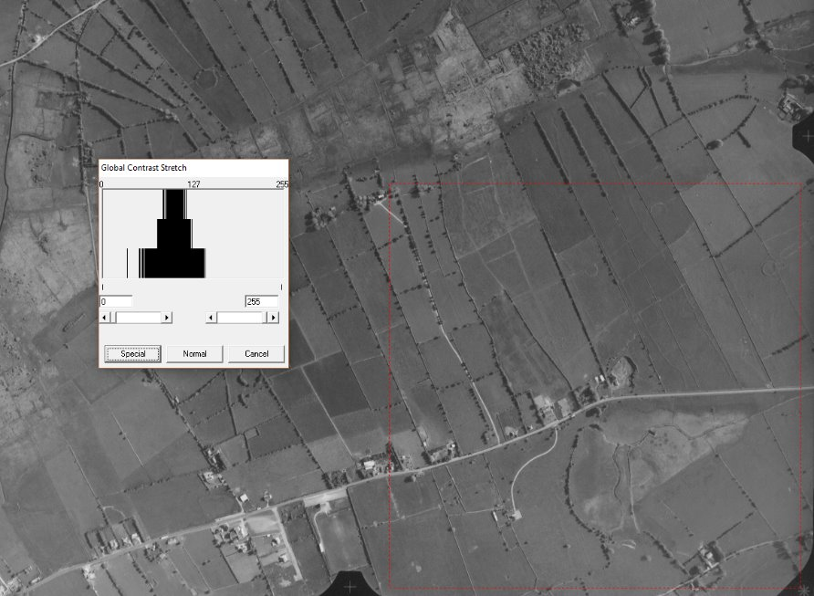
A greyscale aerial photo and its greyscale histogram

Slide 11
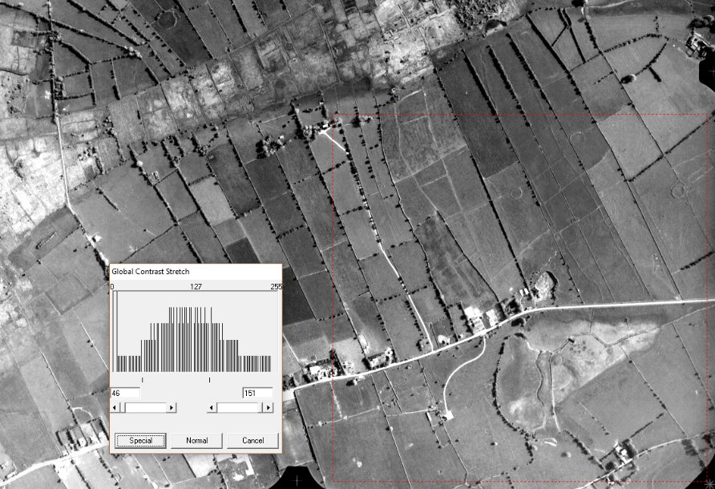
The photo following a global contrast stretch, together with its new greyscale histogram

Slide 12
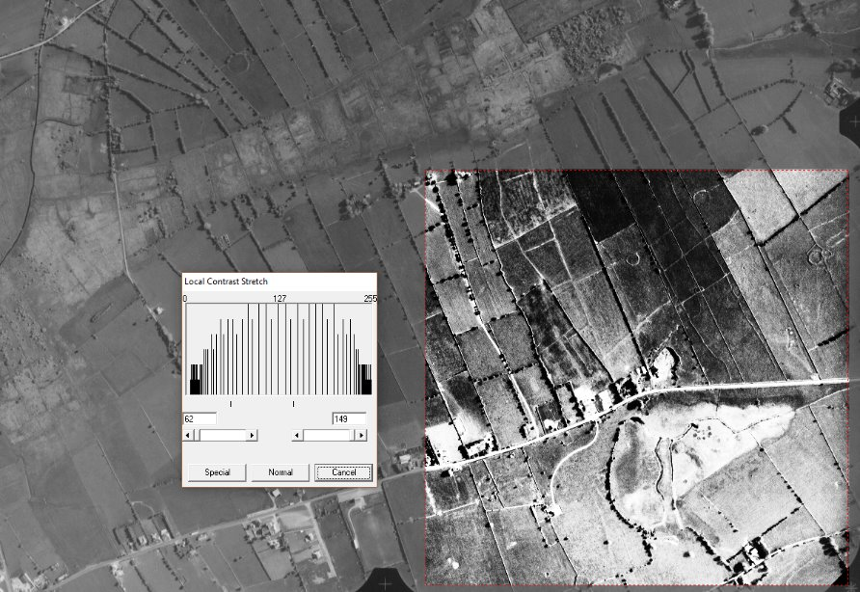
The original photo, now with a local histogram stretch applied​

Slide 13
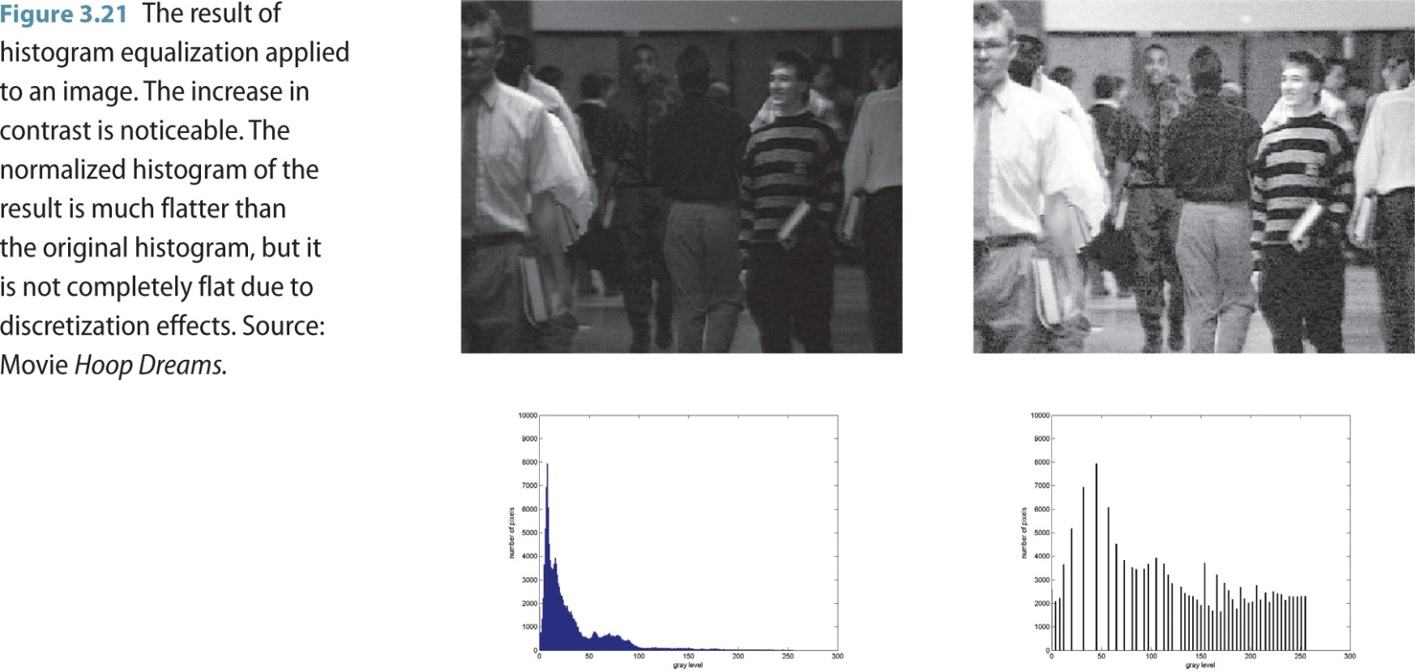
Point Transformations
​Histogram-equalisation: The aim is to maximise the overall contrast and to produce a nearly uniform (i.e. flat) distribution.
Effect? image values are assigned to new values on the basis of their frequency of occurrence: more display values (and hence more detail) are assigned to the frequently occurring portions of the histogram. ​

Slide 14
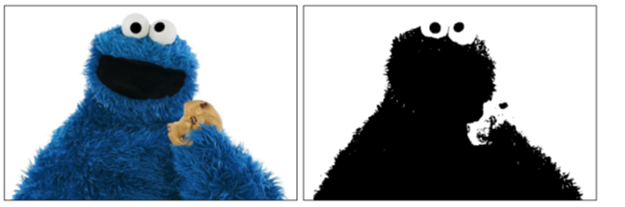
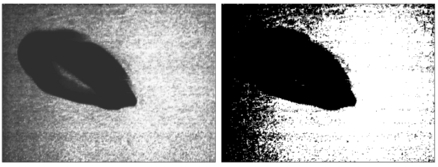
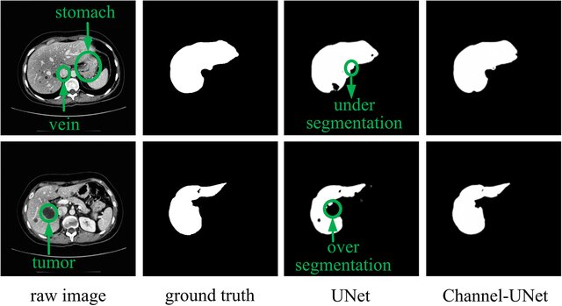
Point Transformations
Example: Thresholding
A simple segmentation technique that is very useful for separating solid objects from a contrasting background. ​
All pixels above a determined (threshold) grey level are assumed to belong to the object, and all pixels below that level are assumed to be outside the object (or vice versa)​
The selection of the threshold level is very important. Problems of over-segmentation (false negatives) vs. under-segmentation (false positives)
[2] Chen, Yilong & Wang, Kai & Liao, Xiangyun & Qian, Yinling & Wang, Qiong & Yuan, Zhiyong & Heng, Pheng-Ann. (2019). Channel-Unet: A Spatial Channel-Wise Convolutional Neural Network for Liver and Tumors Segmentation. Frontiers in Genetics. 10. 1110. 10.3389/fgene.2019.01110.
Image source [2]

Slide 15
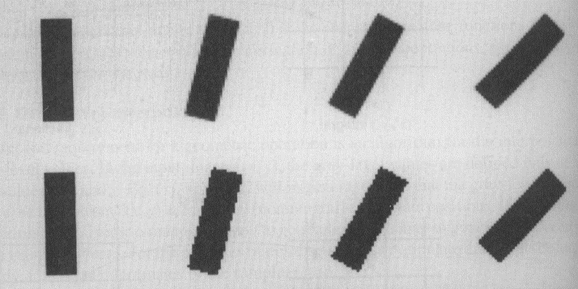
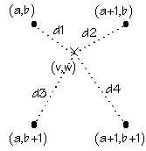
Geometric Transformations
Interpolation: As a 2D array of values, a digital image can be thought of as a sampling of an underlying continuous function. Interpolation estimates this underlying continuous function by computing pixel values at real-valued coordinates where the estimated continuous function must coincide with the sampled data at the sample points
Nearest-neighbour interpolation
Bilinear Interpolation: Bilinear interpolation calculates a distance-weighted average of the 4 pixels closest to the target (sub-pixel) position (v,w)
Bicubic interpolation: more accurate but costly, where derivatives of the underlying function are also estimated.
Using a rotation operation as an example, we can see how bilinear interpolation is superior to nearest neighbour interpolation

Slide 16
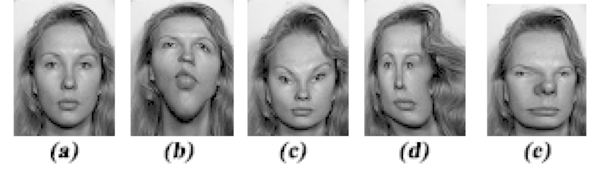
Geometric Transformations
Warping: Arbitrary geometric transformations from real-valued coordinates (x,y) to real-valued coordinates (x’,y’) where the mapping function f(x,y) specifies the transformation, or warping.
Some Applications:
Image rectification
Image registration
Map projection
Image morphing
Image source [3]
[3] Karungaru, Stephen & Fukumi, Minoru & Akamatsu, Norio. (2007). Automatic human faces morphing using genetic algorithms based control points selection. International journal of innovative computing, information & control: IJICIC. 3. .

Slide 17
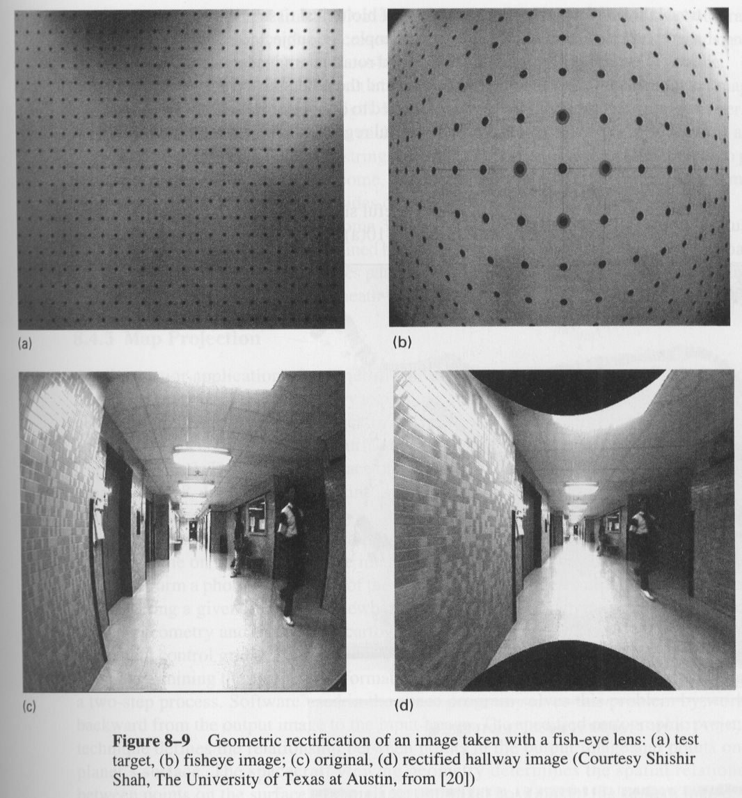
Geometric Transformations
Image rectification
Image rectification (part of camera calibration) is a standard approach to geometric correction consisting of displacement values for specified control points in the image.
Displacements of non-control points are determined through interpolation.
e.g. photograph a rectangular grid and then determine the mapping required to move output control points back to known undistorted positions

Slide 18
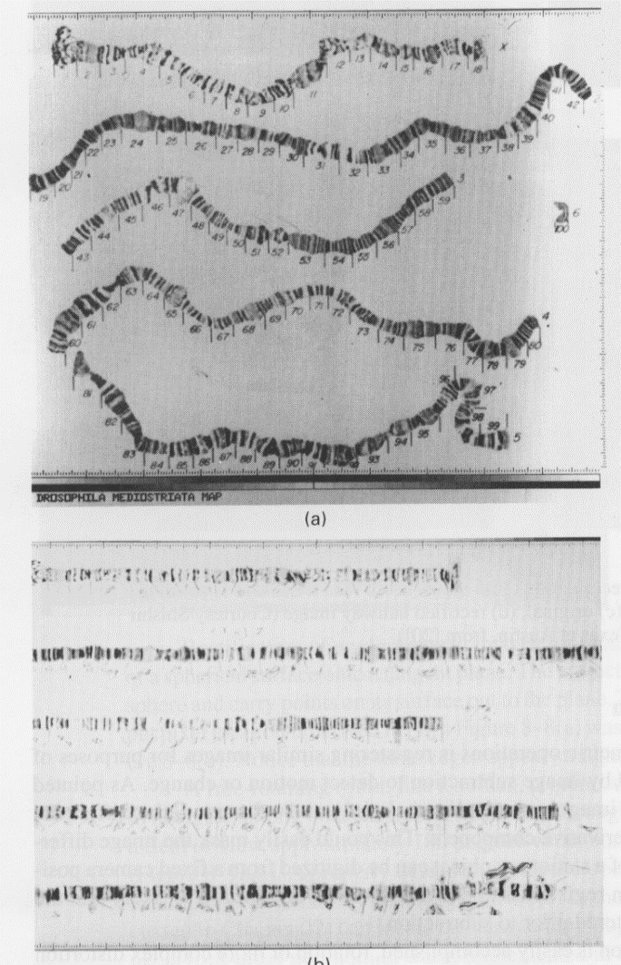
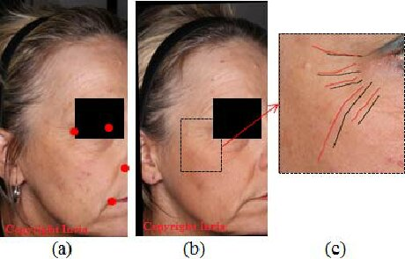
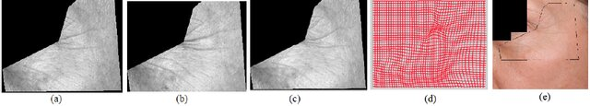
Geometric Transformations
(Medical) Image Registration (Application)
The process of transforming different sets of data into one coordinate system
Geometric operations applied to images for purposes of comparison, monitoring, measurement
Many applications in medical imaging
Chromosome images

Slide 19
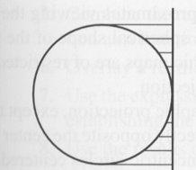
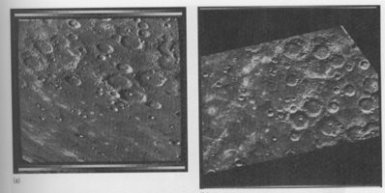
Geometric Transformations
Map Projection (Application)
Map projection: aerial or spaceborne images of the surface of a planet may be rectified into photomaps​
Not only oblique photos but also orthogonal photos require correction, due to shape of surface being imaged​
​Maybe domain knowledge/ assumptions are useful here also? (circular craters)

Slide 20
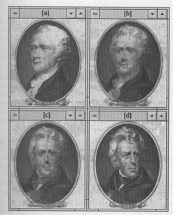
Geometric Transformations
Image Morphing (Application)
Gradually transforms one image into another over a number of animation frames. ​
Involves a dissolve from one image to the other (i.e. gradual change of pixel values), as well as an incremental geometric operation using control points (e.g. nostrils, eyes, chin etc.)​
An interesting site for image morphing examples

Slide 21
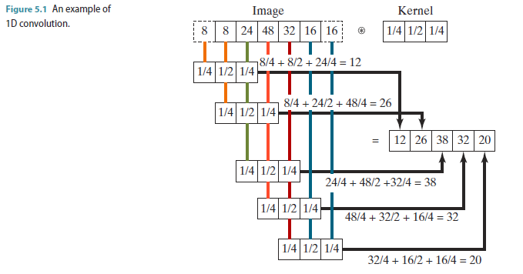
Spatial Filtering (2D-Convolution)
A fundamental local operation in image processing​
Used for a variety of tasks, including noise removal, blurring, sharpening, and edge detection. ​
Establish a moving window ('kernel') which contains an array of coefficients or weighting factors. ​
Move the kernel across the original image, so that it centres on each pixel in turn. Each coefficient in the kernel is multiplied by the value of the pixel below it, and the addition of each of these values determines the value of the pixel in the output image corresponding to the pixel in the centre of the kernel.​
​Why is it called filtering?
*
=

Slide 22
Spatial Filtering (2D-Convolution)
Smoothing kernels: perform an averaging of the values in a local neighborhood and therefore reduce the effects of noise.
Such kernels are often used as the first stage of preprocessing an image that has been corrupted by noise, in order to restore the original image.
Differentiating kernels: accentuate the places where the signal is changing rapidly in value.
used to extract useful information from images, such as the boundaries of objects, for purposes such as object detection.

Slide 23
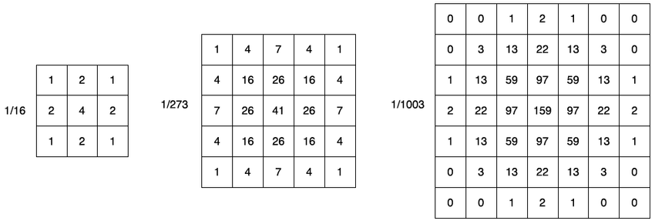
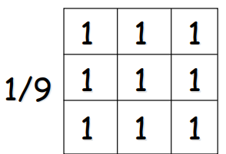
Spatial Filtering – Smoothing filters
Discrete Approximation of Isotropic Gaussian filter 3x3, 5x5, 7x7
Box (Average) Filter

Slide 24
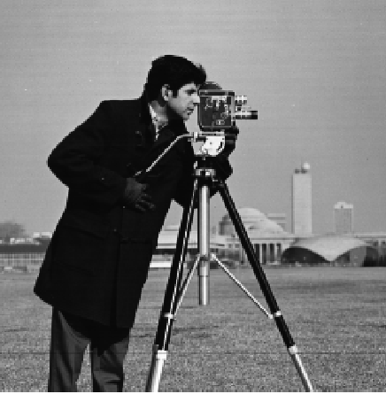
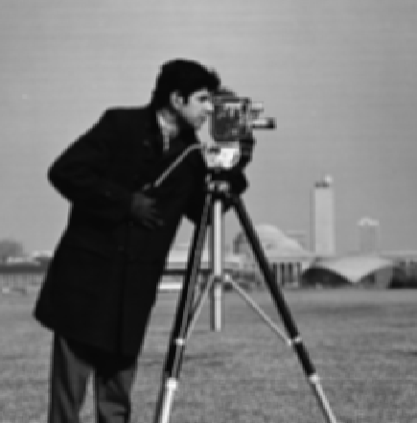

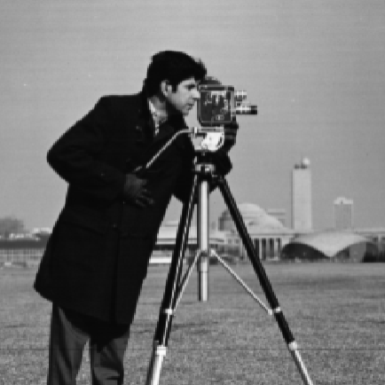

Spatial Filtering – Smoothing filters
Original
Box (Average) Filter 3x3
Gaussian filter: 3x3, sigma 0.5 7x7, sigma 0.5
7x7, sigma 1.5

Slide 25
Next Time
Continue with Spatial Filtering
Filtering in frequency domain – An eye-opener?

Slide 26
Thank you

